Slide 1
Language functions

Slide 2
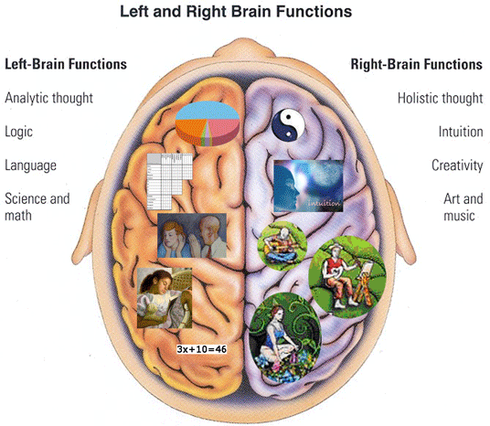

Slide 3
What are language functions?
Language functions are the purpose for which people speak or write. We use language in order to fulfill that purpose.
Wiśniewski (2007) Micro and Macro division
http://anglosopher.com/

Slide 4
Micro and Macro functions According to Kamil Wiśniewski
Micro: Physiological, Phatic, Recording, Identifying, Reasoning, Communicating and Pleasure function.
Macro: Ideational, Interpersonal, Poetic and Textual funtion.

Slide 5
Types of language function
Informative:
Effort to communicate some content.
Expressive
Report feelings or attitudes.
Directive
Used for the purpose of causing.

Slide 6
Examples of language functions
Informative:
“Logic is the study of correct reasoning”
Expressive:
“Ouch!”
Directive:
“Shut the door”

Slide 7
How can we teach language functions?
Situations
Functions
Topics
Your social standing relative to the person you are talking to.
How well you know the person.
Who is listening?
The circumstances under which the communication occurs.

